Slide 1

CO#2 – Relational Model Session#11: Session Topic: SQL- Data Definition Language Database Management and Systems (Course code:)

Slide 2
Data Manipulation Language (DML)
The verbs for the basic SQL commands are:
SELECT - to retrieve (query) data
UPDATE - to modify existing data
DELETE - to modify existing data
INSERT - to add new data
We further break down SQL commands into the following categories:
Data Creation
Data Manipulation
Data Retrieval
Advanced SQL with JOINS, Subqueries and UNIONS

Slide 3
Systems Development Life Cycle
Database Development Process
Project Identification
and Selection
Enterprise modeling
Project Initiation
and Planning
Conceptual data modeling
Analysis
Logical Design
Logical database design
Physical Design
Physical database design and definition
Implementation
Database implementation
Maintenance
Database maintenance

Slide 4
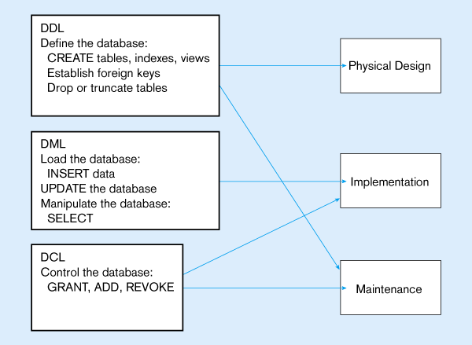

Slide 5
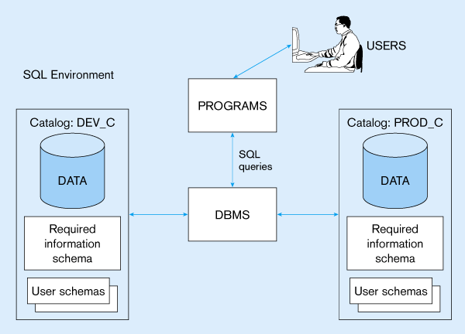


Slide 6
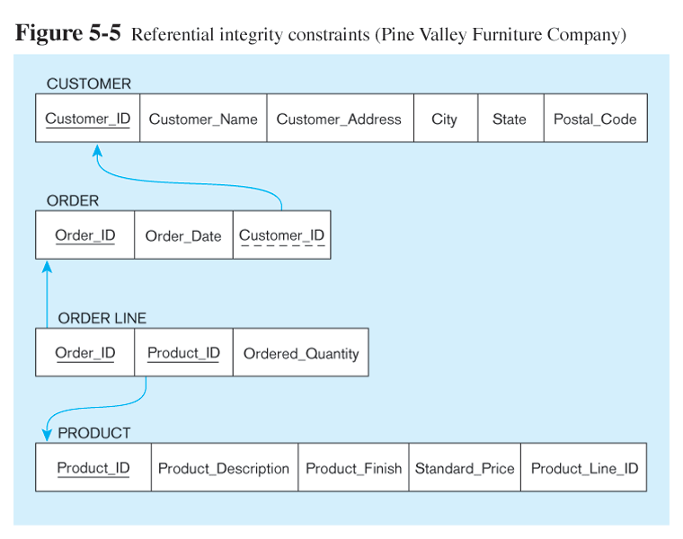
Notes:
Relational Model

Slide 7
SQL Database Definition
Data Definition Language (DDL)
Major CREATE statements:
CREATE SCHEMA – defines a portion of the database owned by a particular user
CREATE TABLE – defines a table and its columns
CREATE VIEW – defines a logical table from one or more views
Other CREATE statements: CHARACTER SET, COLLATION, TRANSLATION, ASSERTION, DOMAIN

Slide 8
SQL - Insert
The SQL INSERT INTO clause is used to insert data into a SQL table. The SQL INSERT INTO is frequently used and has the following generic syntax:
The SQL INSERT INTO clause has actually two parts - the first specifying the table we are inserting into and giving the list of columns we are inserting values for, and the second specifying the values inserted in the column list from the first part.
INSERT INTO Table1 (Column1, Column2, Column3) VALUES (ColumnValue1, ColumnValue2, ColumnValue3)

Slide 9
SQL - Insert
Inserting a record with all fields
INSERT INTO CUSTOMER_T VALUES (001, ‘Contemporary Casuals’, 1355 S. Himes Blvd.’, ‘Gainesville’, ‘FL’, 32601);
Inserting a record with specified fields
INSERT INTO PRODUCT_T (PRODUCT_ID, PRODUCT_DESCRIPTION, PRODUCT_FINISH, STANDARD_PRICE, PRODUCT_ON_HAND) VALUES (1, ‘End Table’, ‘Cherry’, 175, 8);
Inserting records from another table
INSERT INTO CA_CUSTOMER_T SELECT * FROM CUSTOMER_T WHERE STATE = ‘CA’;

Slide 10
SQL – Delete
The SQL DELETE Query is used to delete the existing records from a table.
You can use WHERE clause with DELETE query to delete selected rows, otherwise all the records would be deleted.
Removes rows from a table
Delete certain rows
DELETE FROM CUSTOMER_T WHERE STATE = ‘HI’;
Delete all rows
DELETE FROM CUSTOMER_T;

Slide 11
SQL - Drop
The SQL DROP TABLE statement is used to remove a table definition and all data, indexes, triggers, constraints, and permission specifications for that table.
NOTE: You have to be careful while using this command because once a table is deleted then all the information available in the table would also be lost forever.
The SQL TRUNCATE TABLE command is used to delete complete data from an existing table.
You can also use DROP TABLE command to delete complete table but it would remove complete table structure form the database and you would need to re-create this table once again if you wish you store some data.

Slide 12
SQL - Update
The SQL UPDATE command is used to modify data stored in database tables.
Modifies data in existing rows
UPDATE PRODUCT_T
SET UNIT_PRICE = 775
WHERE PRODUCT_ID = 7;

Slide 13
SQL - Select
SQL SELECT is without a doubt the most frequently used SQL command that's why we are starting our tutorial with it. The SQL SELECT command is used to retrieve data from one or more database tables.
Clauses of the SELECT statement:
SELECT - List the columns (and expressions) that should be returned from the query
FROM - Indicate the table(s) or view(s) from which data will be obtained
WHERE - Indicate the conditions under which a row will be included in the result
GROUP BY - Indicate columns to group the results
HAVING - Indicate the conditions under which a group will be included
ORDER BY - Sorts the result according to specified columns

Slide 14
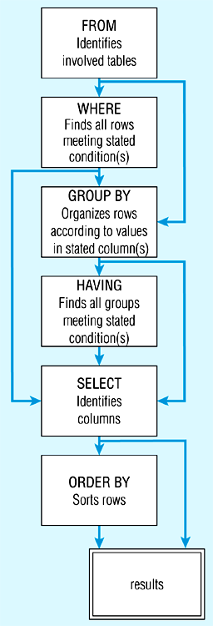
SQL Statement processing order

Slide 15
SQL Comparison Operators
Operator | Meaning
= | Equal To
> | Greater Than
>= | Greater Than or Equal To
< | Less Than
<= | Less Than or Equal To
<> | Not Equal To
!= | Not Equal To

Slide 16
SQL Aliases
SQL aliases are used to give a database table, or a column in a table, a temporary name.
Basically aliases are created to make column names more readable.
SELECT CUST.CUSTOMER AS NAME, CUST.CUSTOMER_ADDRESS
FROM CUSTOMER_V CUST
WHERE NAME = ‘Home Furnishings’;

Slide 17
SQL Aggregate Functions
SQL aggregate functions return a single value, calculated from values in a column.
Useful aggregate functions:
AVG() - Returns the average value
COUNT() - Returns the number of rows
FIRST() - Returns the first value
LAST() - Returns the last value
MAX() - Returns the largest value
MIN() - Returns the smallest value
SUM() - Returns the sum

Slide 18
SQL Aggregate Functions
Using the COUNT aggregate function to find totals
The COUNT(column_name) function returns the number of values (NULL values will not be counted) of the specified column:
SELECT COUNT(*) FROM ORDER_LINE_V
WHERE ORDER_ID = 1004;

Slide 19
SQL Boolean Operators
AND, OR, and NOT Operators for customizing conditions in WHERE clause
The AND operator displays a record if both the first condition AND the second condition are true.
The OR operator displays a record if either the first condition OR the second condition is true.
SELECT PRODUCT_DESCRIPTION, PRODUCT_FINISH, STANDARD_PRICE
FROM PRODUCT_V
WHERE (PRODUCT_DESCRIPTION LIKE ‘%Desk’
OR PRODUCT_DESCRIPTION LIKE ‘%Table’)
AND UNIT_PRICE > 300;
Notes:
Note: the LIKE operator allows you to compare strings using wildcards. For example, the % wildcard in ‘%Desk’ indicates that all strings that have any number of characters preceding the word “Desk” will be allowed

Slide 20
SQL Between Operator
The BETWEEN operator selects values within a range. The values can be numbers, text, or dates.
SELECT column_name(s) FROM table_name WHERE column_name BETWEEN value1 AND value2;

Slide 21
SQL Wildcards
In SQL, wildcard characters are used with the SQL LIKE operator.
SQL wildcards are used to search for data within a table.
With SQL, the wildcards are:
Wildcard | Description
% | A substitute for zero or more characters
_ | A substitute for a single character
[charlist] | Sets and ranges of characters to match
[^charlist] or [!charlist] | Matches only a character NOT specified within the brackets

Slide 22
SQL Order Clause
The ORDER BY keyword is used to sort the result-set by one or more columns.
The ORDER BY keyword sorts the records in ascending order by default. To sort the records in a descending order, you can use the DESC keyword.
SELECT CUSTOMER_NAME, CITY, STATE
FROM CUSTOMER_V
WHERE STATE IN (‘FL’, ‘TX’, ‘CA’, ‘HI’)
ORDER BY STATE, CUSTOMER_NAME;
Notes:
Note: the IN operator in this example allows you to include rows whose STATE value is either FL, TX, CA, or HI. It is more efficient than separate OR conditions

Slide 23
SQL Group Clause
Categorizing results
SELECT STATE, COUNT(STATE)
FROM CUSTOMER_V
GROUP BY STATE;
Notes:
Note: you can use single-value fields with aggregate functions if they are included in the GROUP BY clause

Slide 24
SQL Having Clause
For use with GROUP BY
SELECT STATE, COUNT(STATE)
FROM CUSTOMER_V
GROUP BY STATE
HAVING COUNT(STATE) > 1;
Like a WHERE clause, but it operates on groups (categories), not on individual rows. Here, only those groups with total numbers greater than 1 will be included in final result

Slide 25
SQL Distinct
The SQL DISTINCT keyword is used in conjunction with SELECT statement to eliminate all the duplicate records and fetching only unique records.
There may be a situation when you have multiple duplicate records in a table. While fetching such records, it makes more sense to fetch only unique records instead of fetching duplicate records.
SELECT DISTINCT column1, column2,.....columnN
FROM table_name
WHERE [condition]

Slide 26
Summary
The Structured Query Language (SQL) defines a standard for interacting with relational databases
Most platforms support ANSI-SQL 92
Most platforms provide many non-ANSI-SQL additions
Most important data modification SQL statements:
SELECT: Returning rows
UPDATE: Modifying existing rows
INSERT: Creating new rows
DELETE: Removing existing rows

Slide 27
References
Text Book: Database System Concepts, Sixth Edition, Abraham Silberschatz, Yale University Henry, F. Korth Lehigh University, S. Sudarshan Indian Institute of Technology, Bombay.

